Slide 1
Application of Graph Theory to Modeling and Visualization of Epidemiology Data
Group F: Ayan Ali Mohammed Jason Driscoll Jeswanth Reddy Dwaram Sathish Reddy Kallu

Slide 2
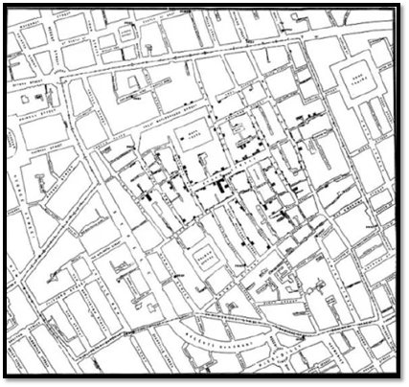
Research Problem:
Issue with Traditional Models:
Heavy reliance on geographic data in epidemiology
Issues with traditional methods:
High-dimensional data increases computational cost
Misleading spatial relationships
Inefficiencies in certain health studies
Proposed Solution:
Graph Theory: Models regions as nodes and relationships as edges
Potential benefits:
More efficient and accurate modeling
Detects hidden patterns in health data
Significance:
Improved disease modeling for better public health strategies
Lower computational costs, making research more accessible
Enhanced data visualization for policymakers and researchers
Figure 1: John Snow’s Map of Cholera Casualties.
Data Source: M. Popova, “The Ghost Map: Hard Lessons in Epidemiology from Victorian London,” The Marginalian. Accessed: Feb. 12, 2025. [Online]. Available: https://www.themarginalian.org/2011/08/26/the-ghost-map-steven-johnson/

Slide 3
Objectives
Primary Goal
Apply Graph Theory to epidemiology data
Explore Network Theory concept:
Closeness and centrality (identifying key regions)
Clustering (detecting disease outbreak zones)
Flow and diffusion (understanding disease spread patterns)
Secondary Goal
Study the relationship between Superfund sites and environmental exposure
Use bipartite graphs to model risk factors

Slide 4
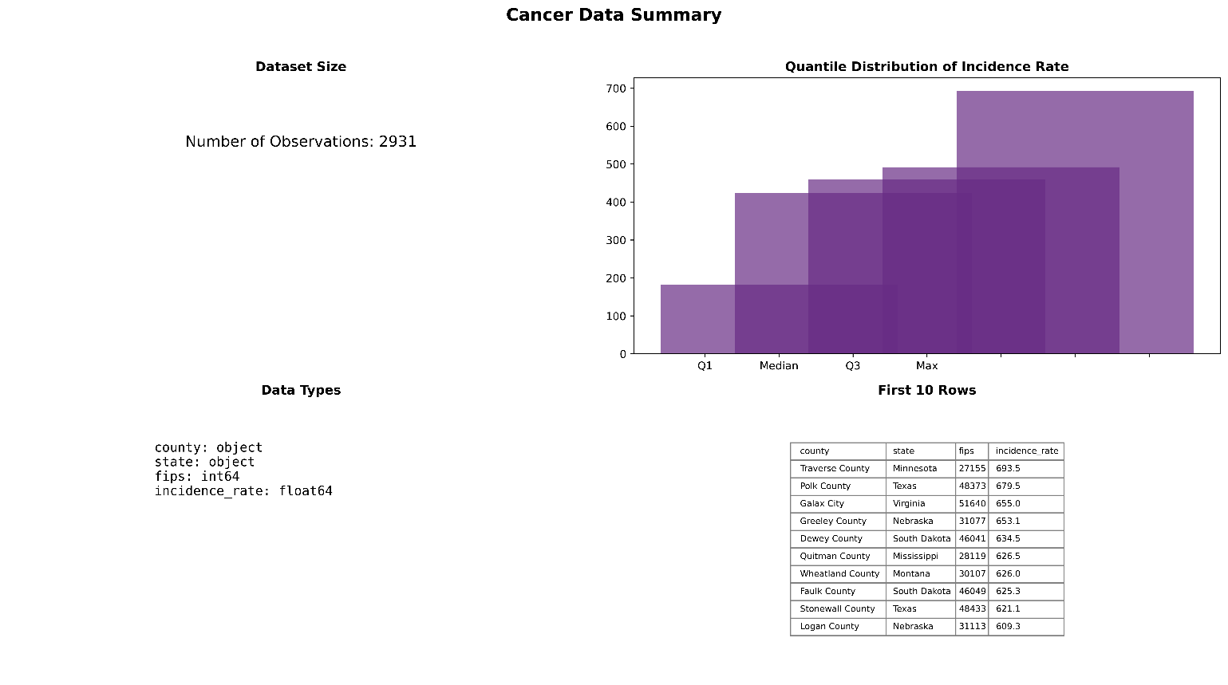
Dataset Overview
Exploratory Data Analysis (EDA) of Three datasets:
Cancer Incidence Rate Dataset
Superfund Sites Dataset
Infectious Diseases Dataset
1. Cancer Incidence Rate Dataset
Source: www.statecancerprofiles.cancer.gov
Size: 3,144 rows, 15 columns (raw data); after preprocessing, 2,932 rows, 4 key columns.
Key Features:
County: Name of the county.
State: Name of the state.
FIPS: Federal Information Processing Standards (FIPS) code, a unique identifier for geographical locations.
Age-Adjusted Incidence Rate: Number of cancer cases per 100,000 people.

Slide 5
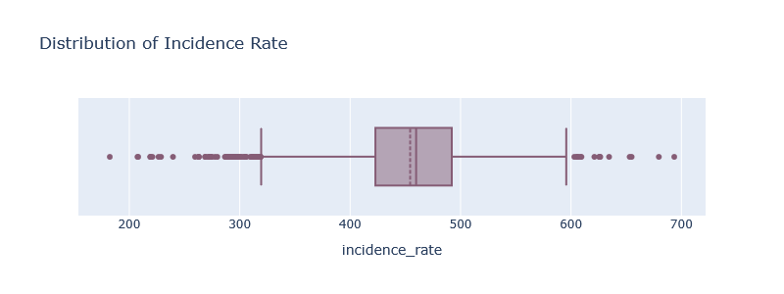
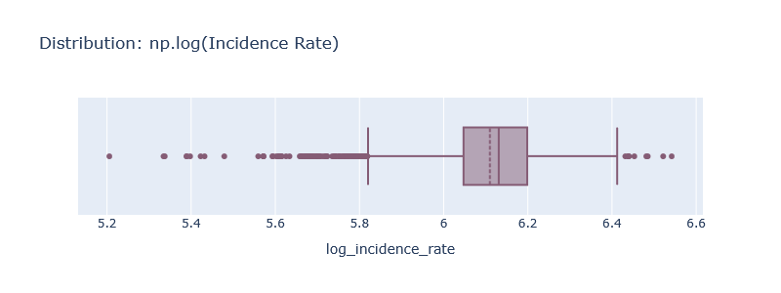
Box Plot of Incidence Rate:
Shows the spread of cancer incidence rates across counties.
Original incidence rate distribution was plotted using box plots
The skewness was explicitly calculated, likely showing a positive skew.
Log Transformation:
The log of incidence rates was calculated to reduce skewness
The log-transformed box plot was created to compare distributions before and after normalization.

Slide 6
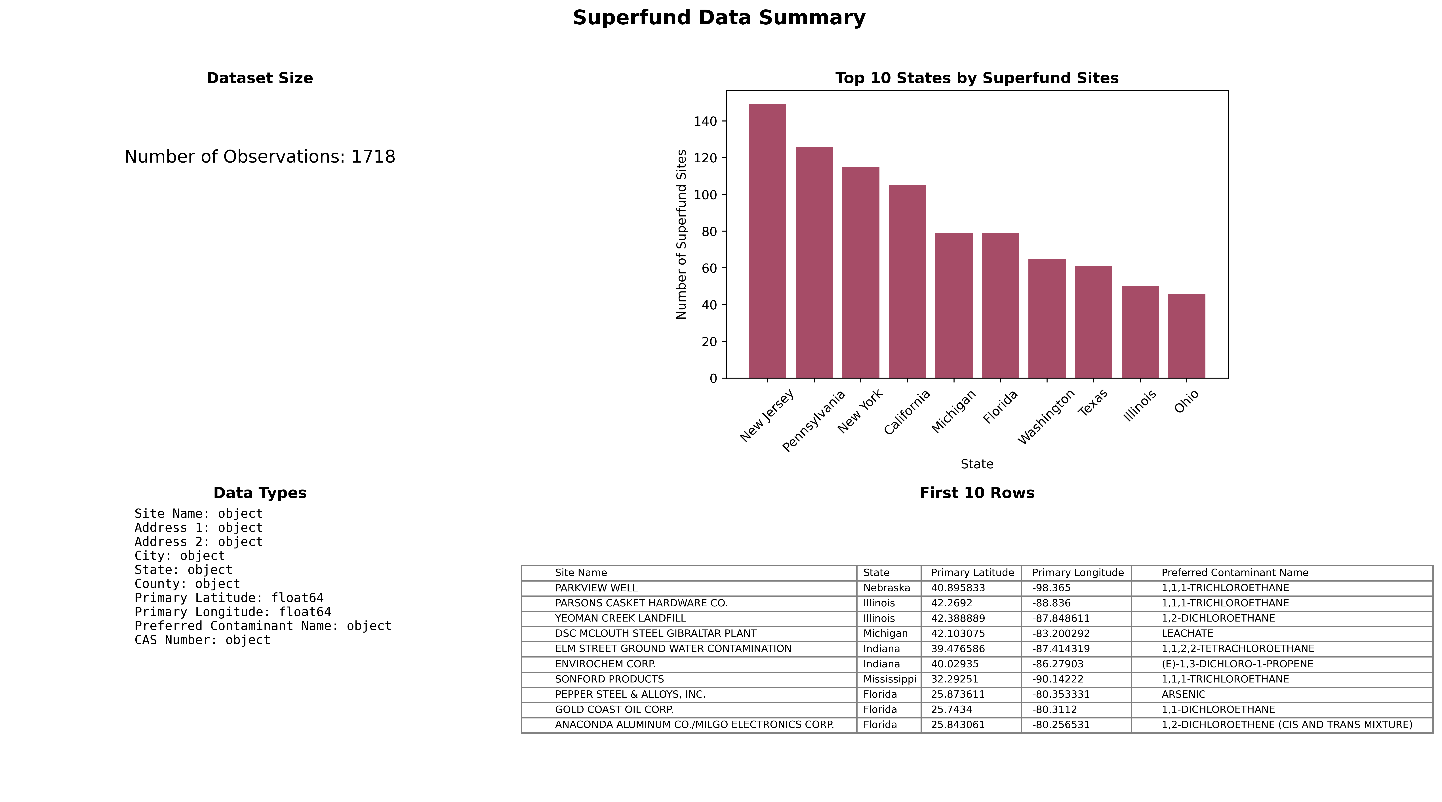
2. Superfund Sites Dataset
Source:
EPA Superfund Data and Report
https://www.epa.gov/superfund/superfund-data-and-reports?utm_source=chatgpt.com
Size: 47,041 rows, 21 columns (raw data); after preprocessing, 1,718 rows, 5 key columns.
Key Features:
Site Name: Name of the hazardous waste site.
Address 1: Primary address of the site.
County: County where the site is located.
Primary Latitude: Geographical latitude of the site.
Primary Longitude: Geographical longitude of the site.

Slide 7
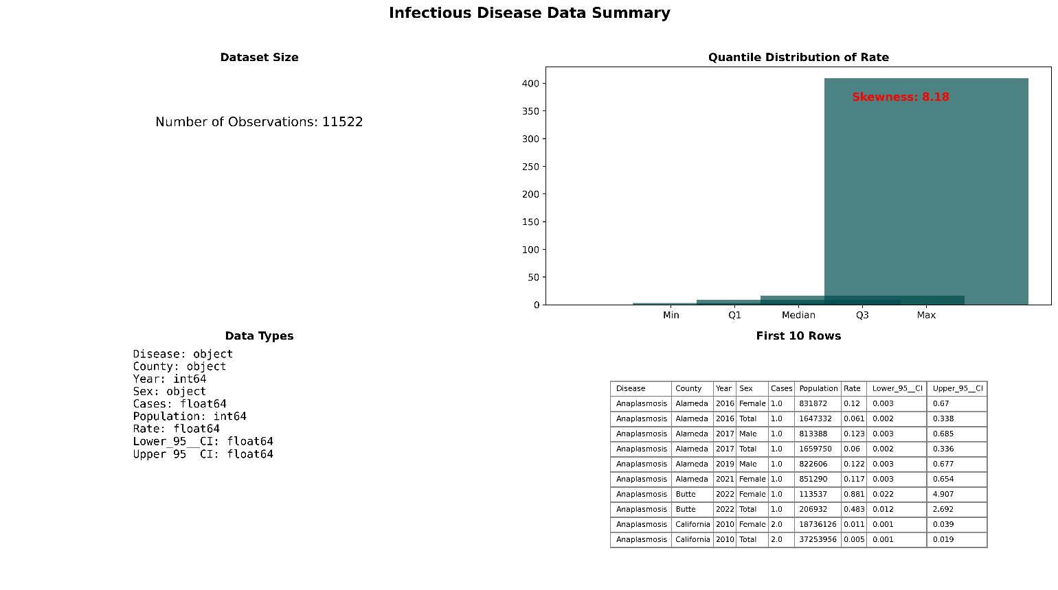
Infectious Diseases Dataset
Source - California Public Health/Epidemiology
Records by:
County
Year
Sex
Size (after removing duplicates/Nas): 11,522 rows, 9 columns
Skewness: High
Number of Features: 9
Key Features:
Disease: Name of the infectious disease.
County: Geographic location of the reported cases.
Year: Year when the cases were recorded.
Sex: Gender of affected individuals.
Rate: Rate of Infection

Slide 8
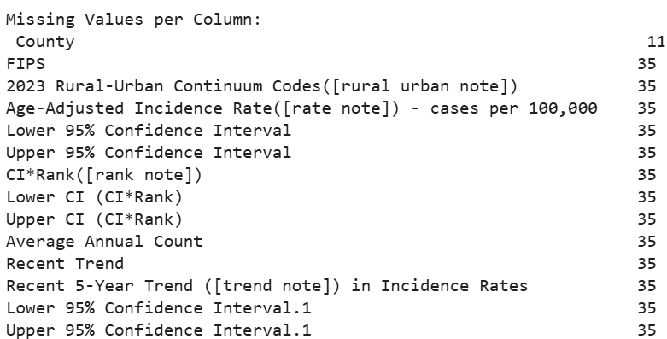
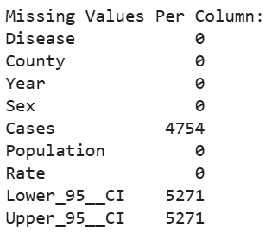
Data Cleaning & Preprocessing Techniques
Handling Missing Values
Handling Duplicates
Converting Data Types
Renaming Columns
Trimming Whitespace & Replacing Inconsistent Values

Slide 9
Feature Engineering or Transformation
Feature Merging:
Merged cancer incidence rates with county geospatial data
Proximity Features:
Created binary classification for counties near major rivers (Missouri, Mississippi, and Ohio)
Spatial Distance Calculation:
Used geospatial distance metrics to quantify proximity to potential contamination sources

Slide 10
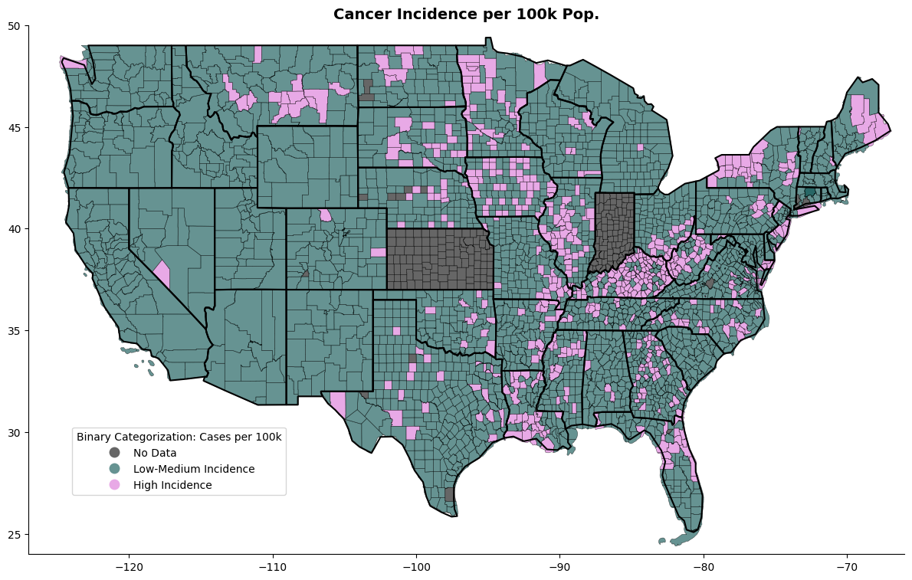
Univariate Analysis:
Map shows the distribution of cancer incidence rates across U.S. counties. High-incidence areas (pink) are concentrated in specific regions, while gray counties have missing data

Slide 11
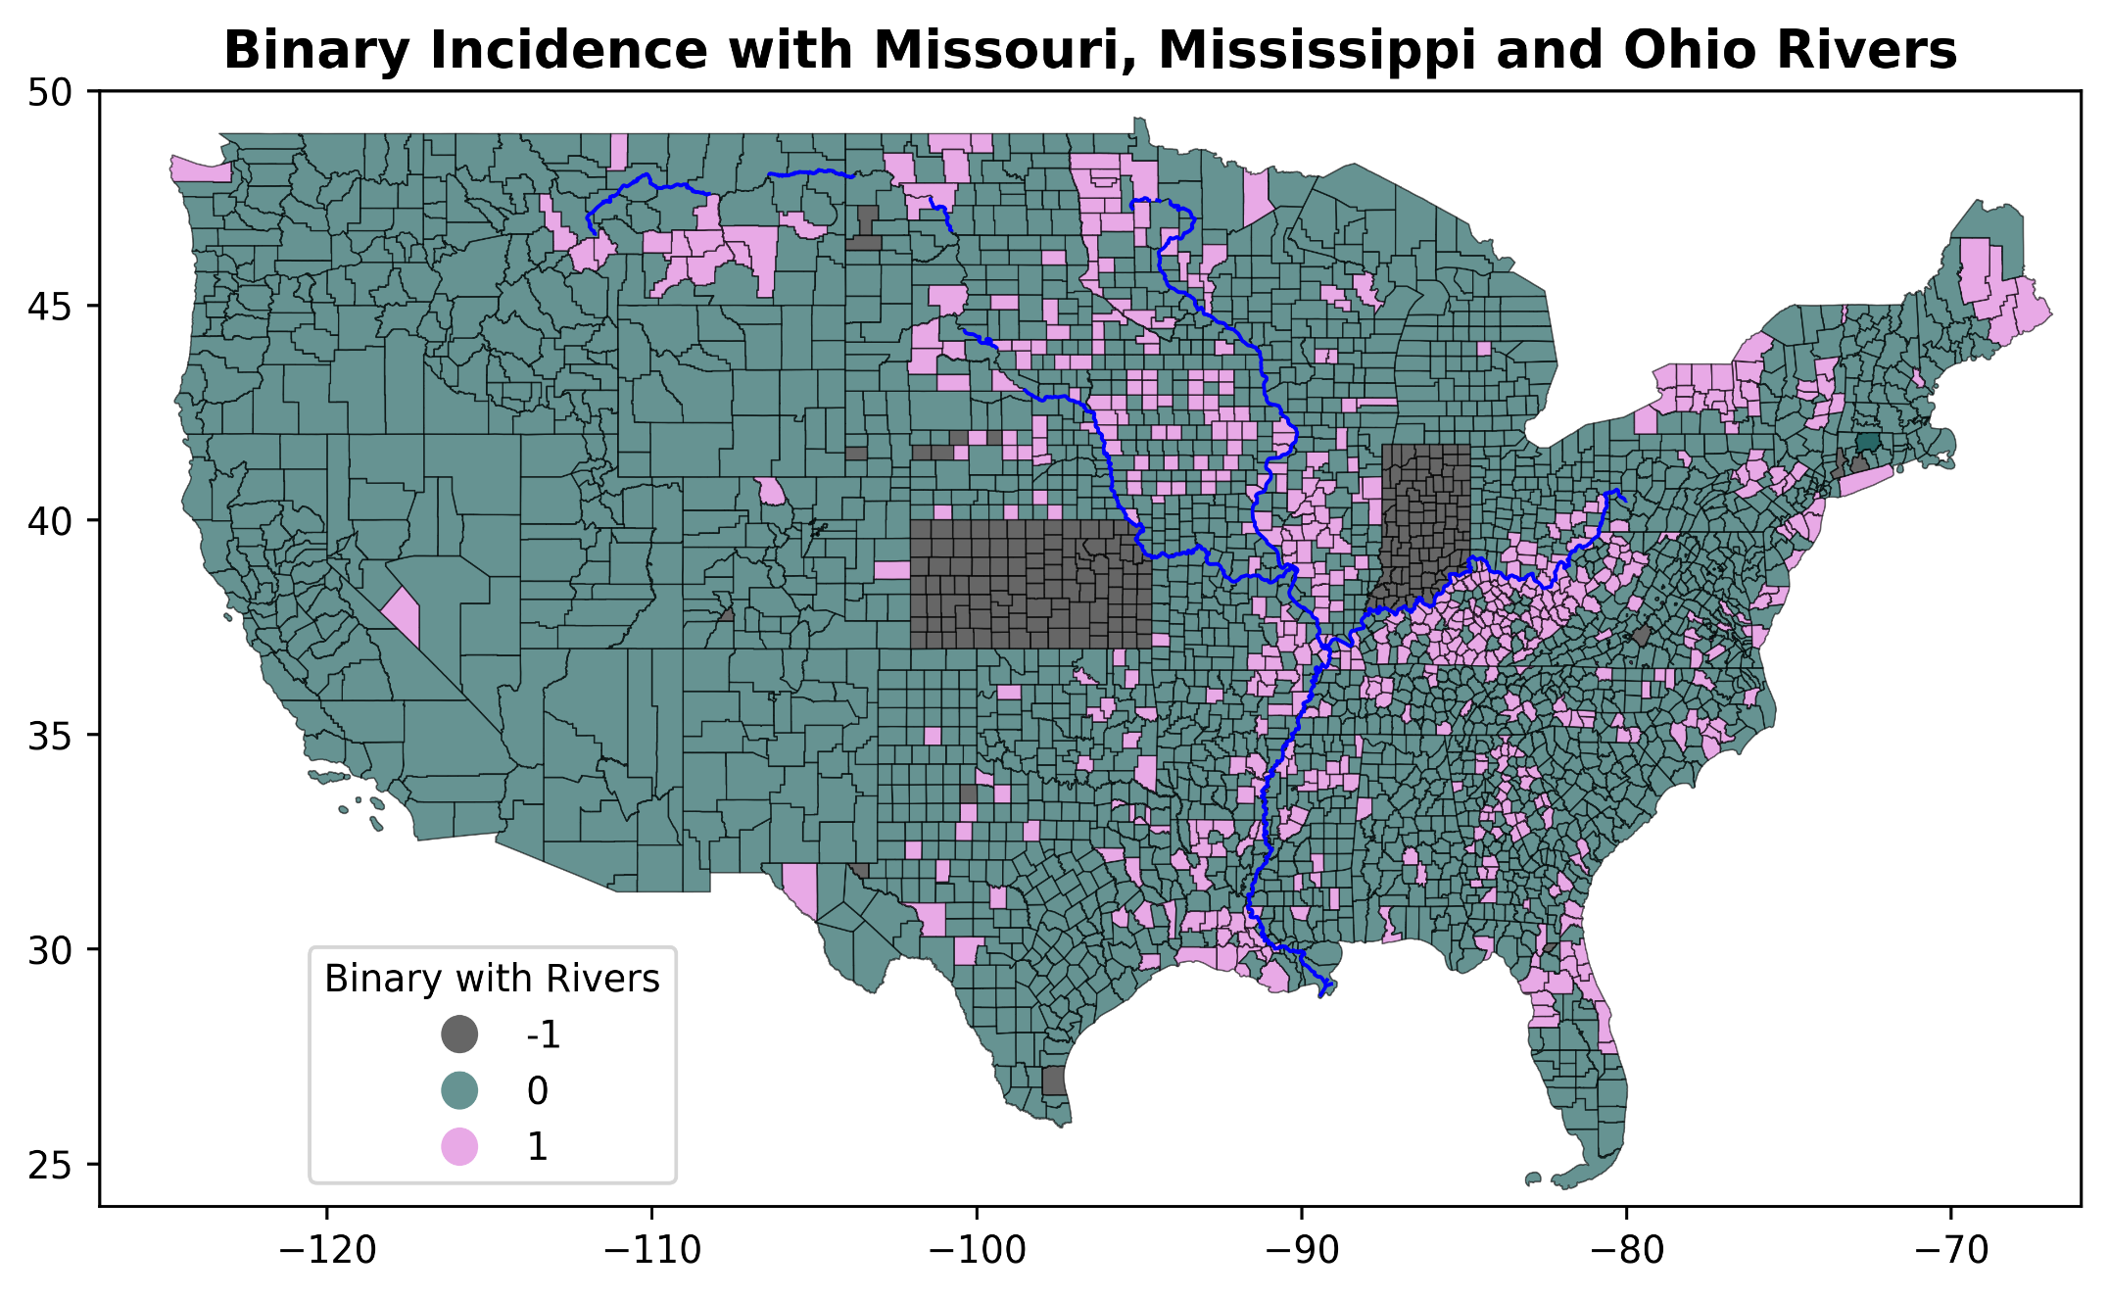
Multivariate Analysis
Cancer Incidence & Proximity to Major River
Visualization overlays major river systems (Missouri, Mississippi, and Ohio) on cancer incidence data. The correlation suggests potential environmental factors related to water sources that may influence cancer rates in certain counties.

Slide 12
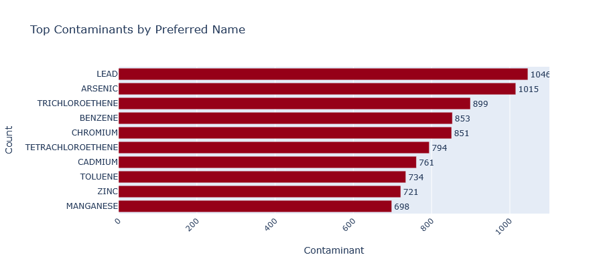
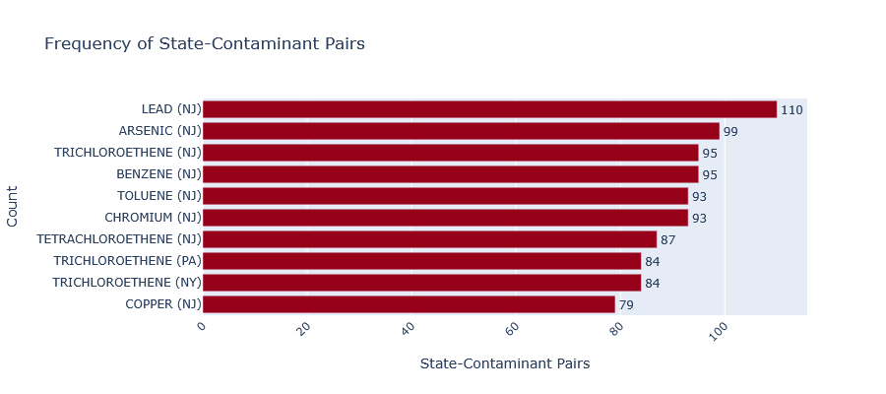
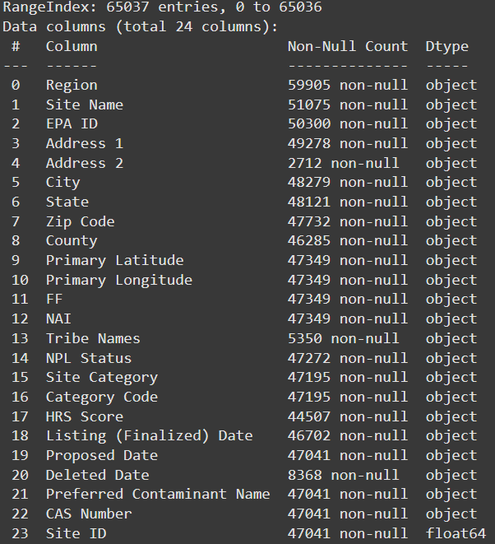
EDA – Limitations, Challenges and Issues Encountered
Complexity – Dimensionality – Magnitude of Relationships
Data Complete – Standardization – Geography is Hard

Slide 13
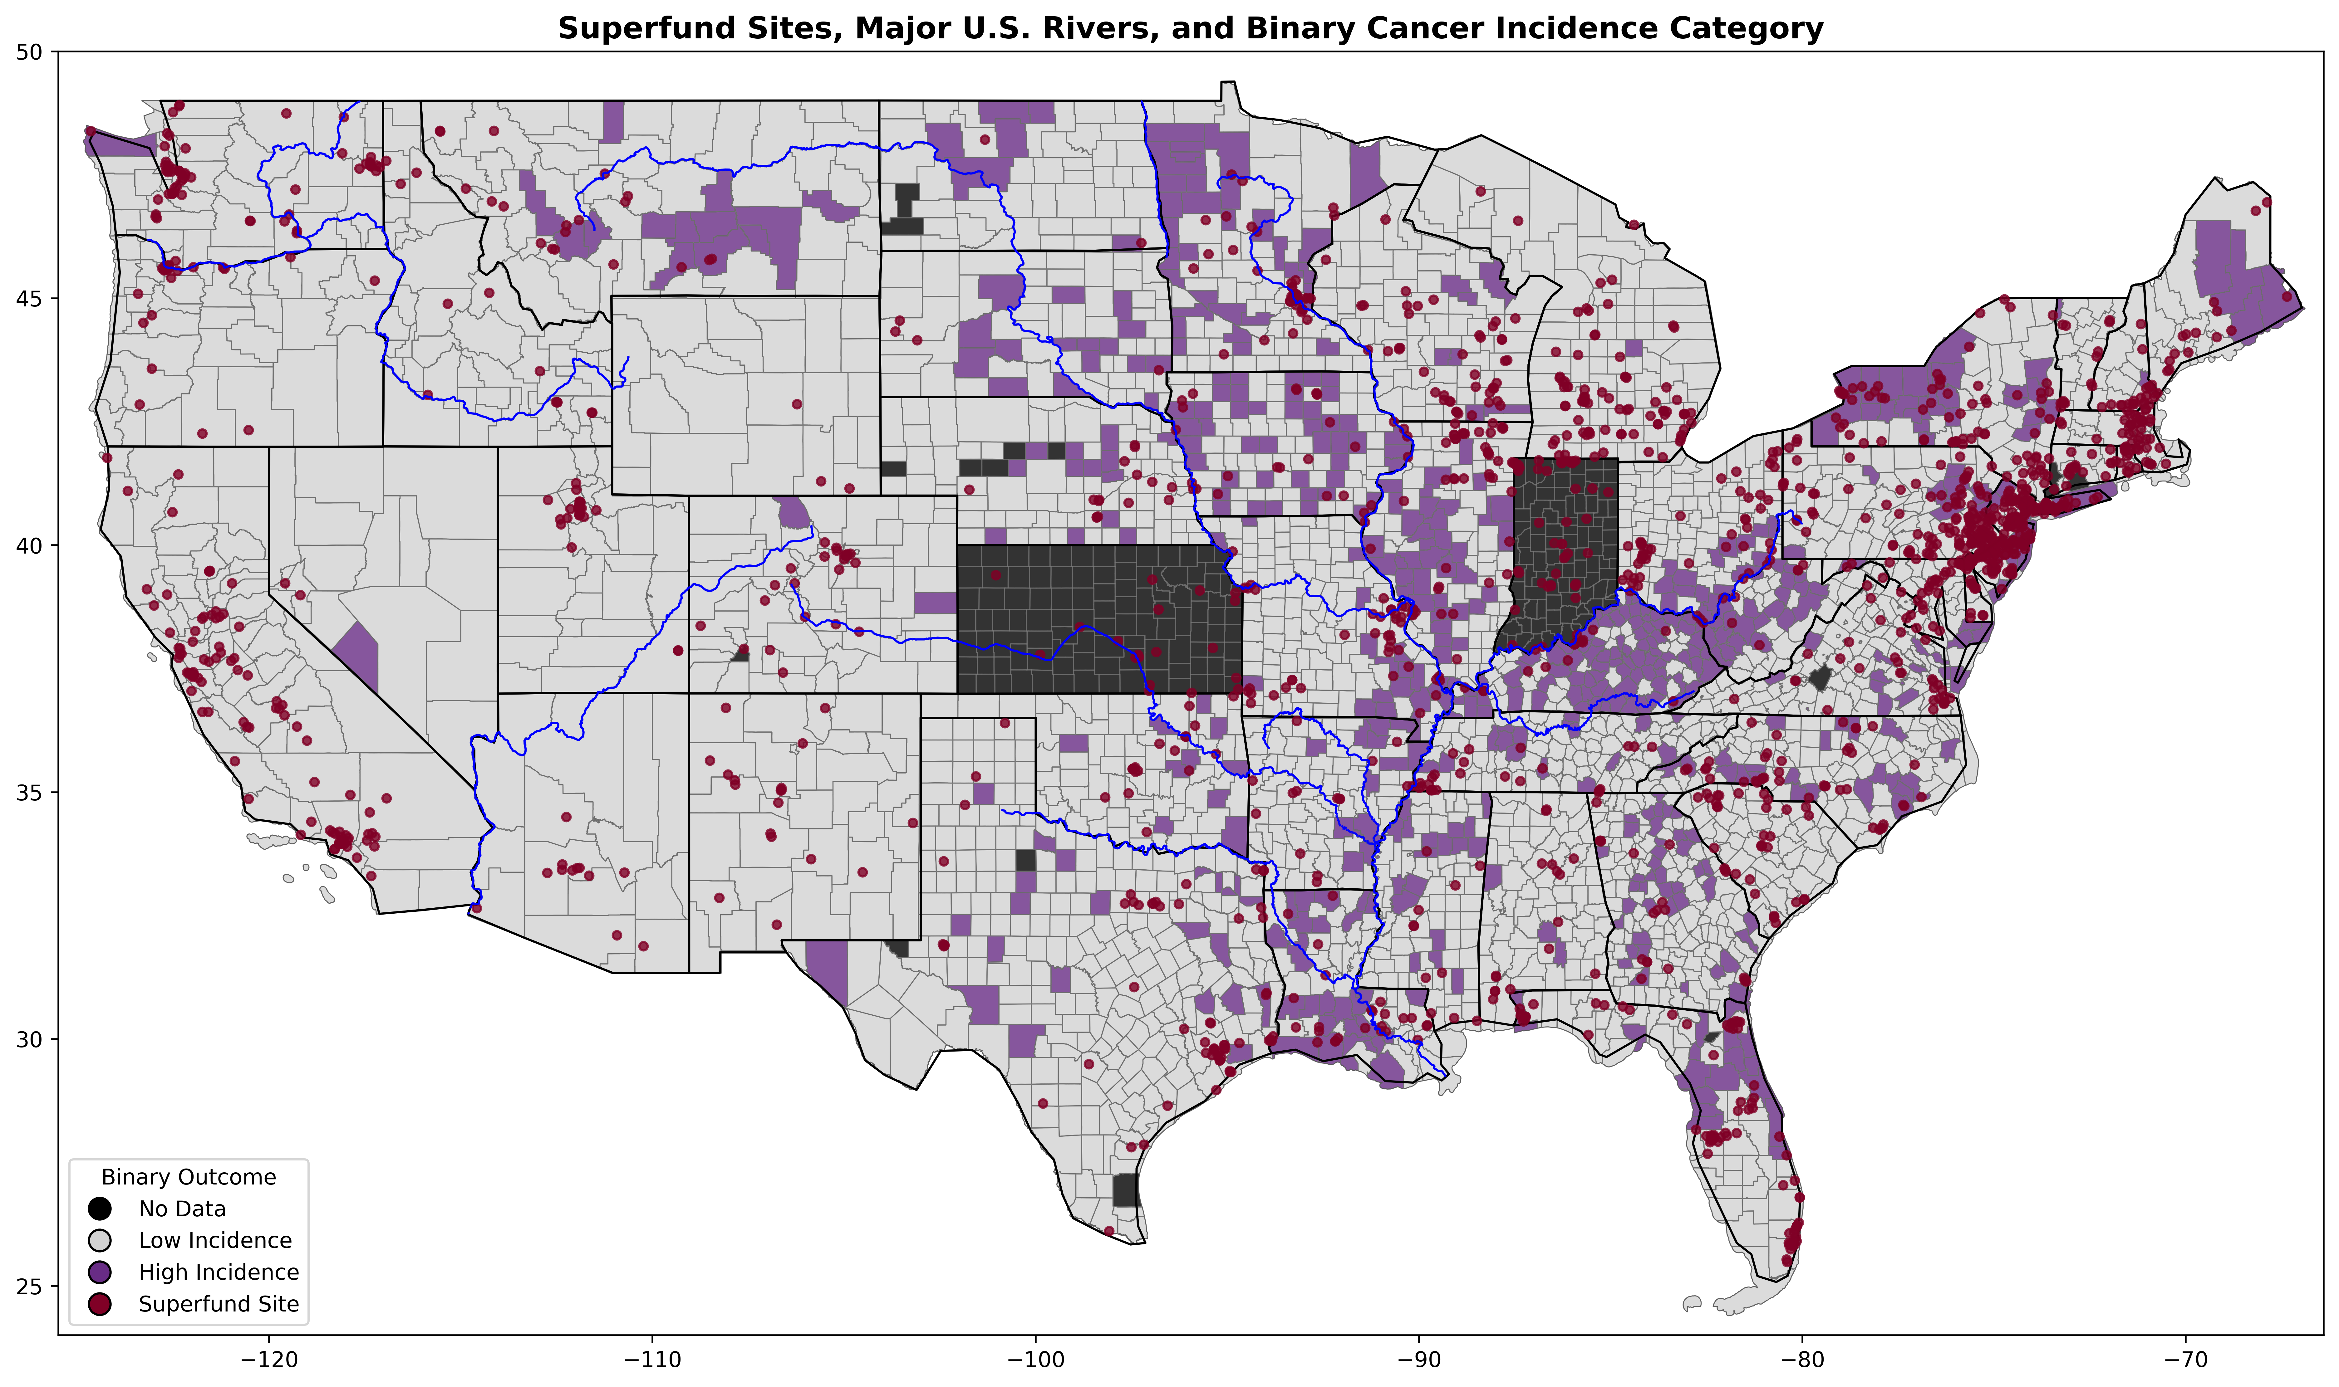
Multi-variate Geographic Visualization
Assumptions
There are relationships between disease patterns and environmental hazards.
These patterns can be influenced by the presence of natural pathways.
Node-and-edge analysis can enhance modeling abilities in areas standard methods struggle.

Slide 14
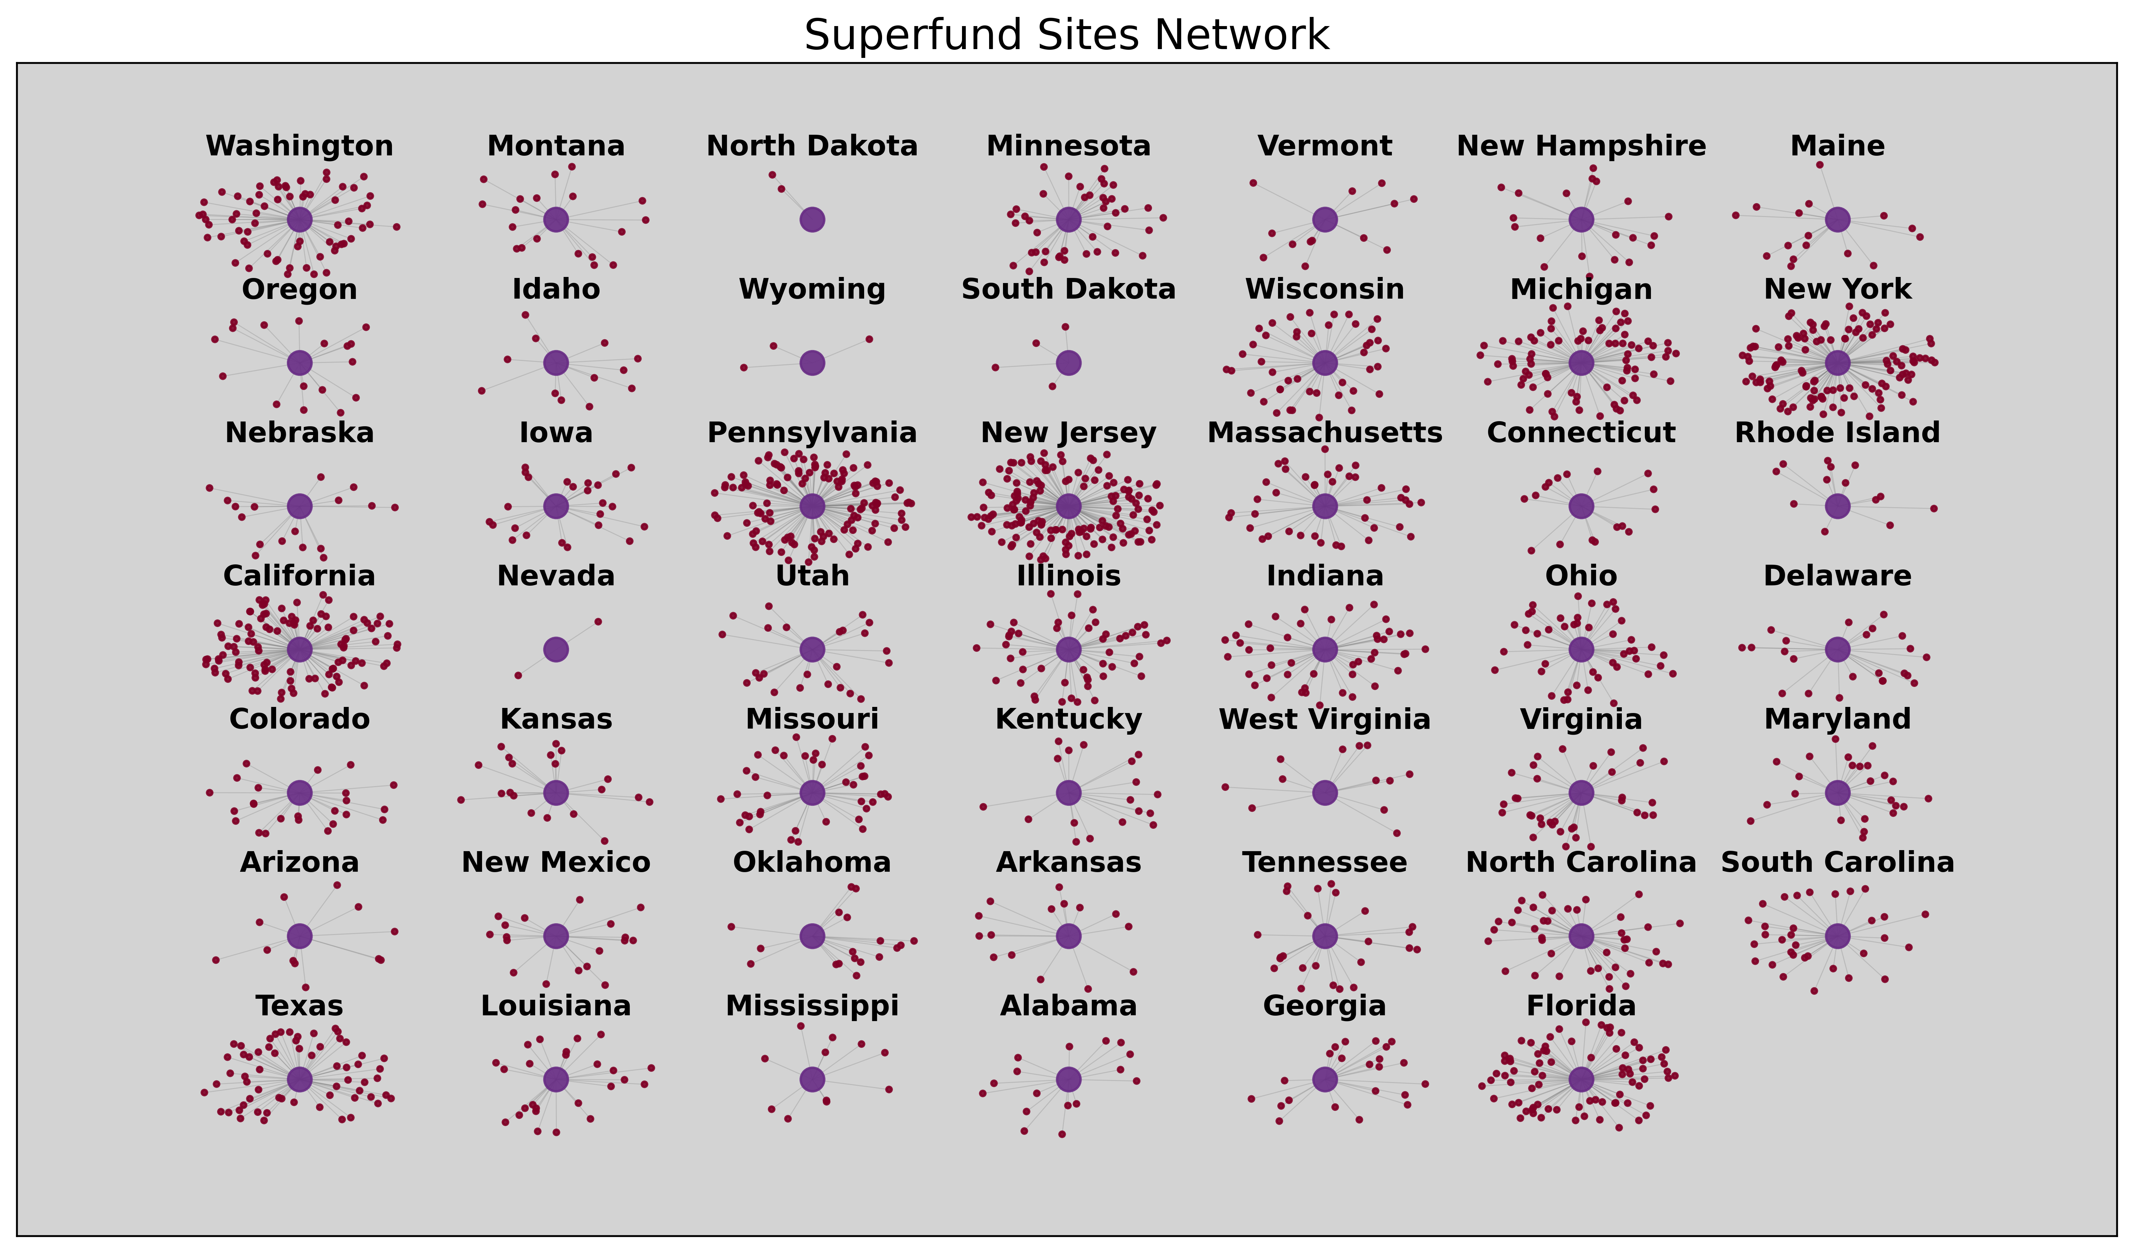
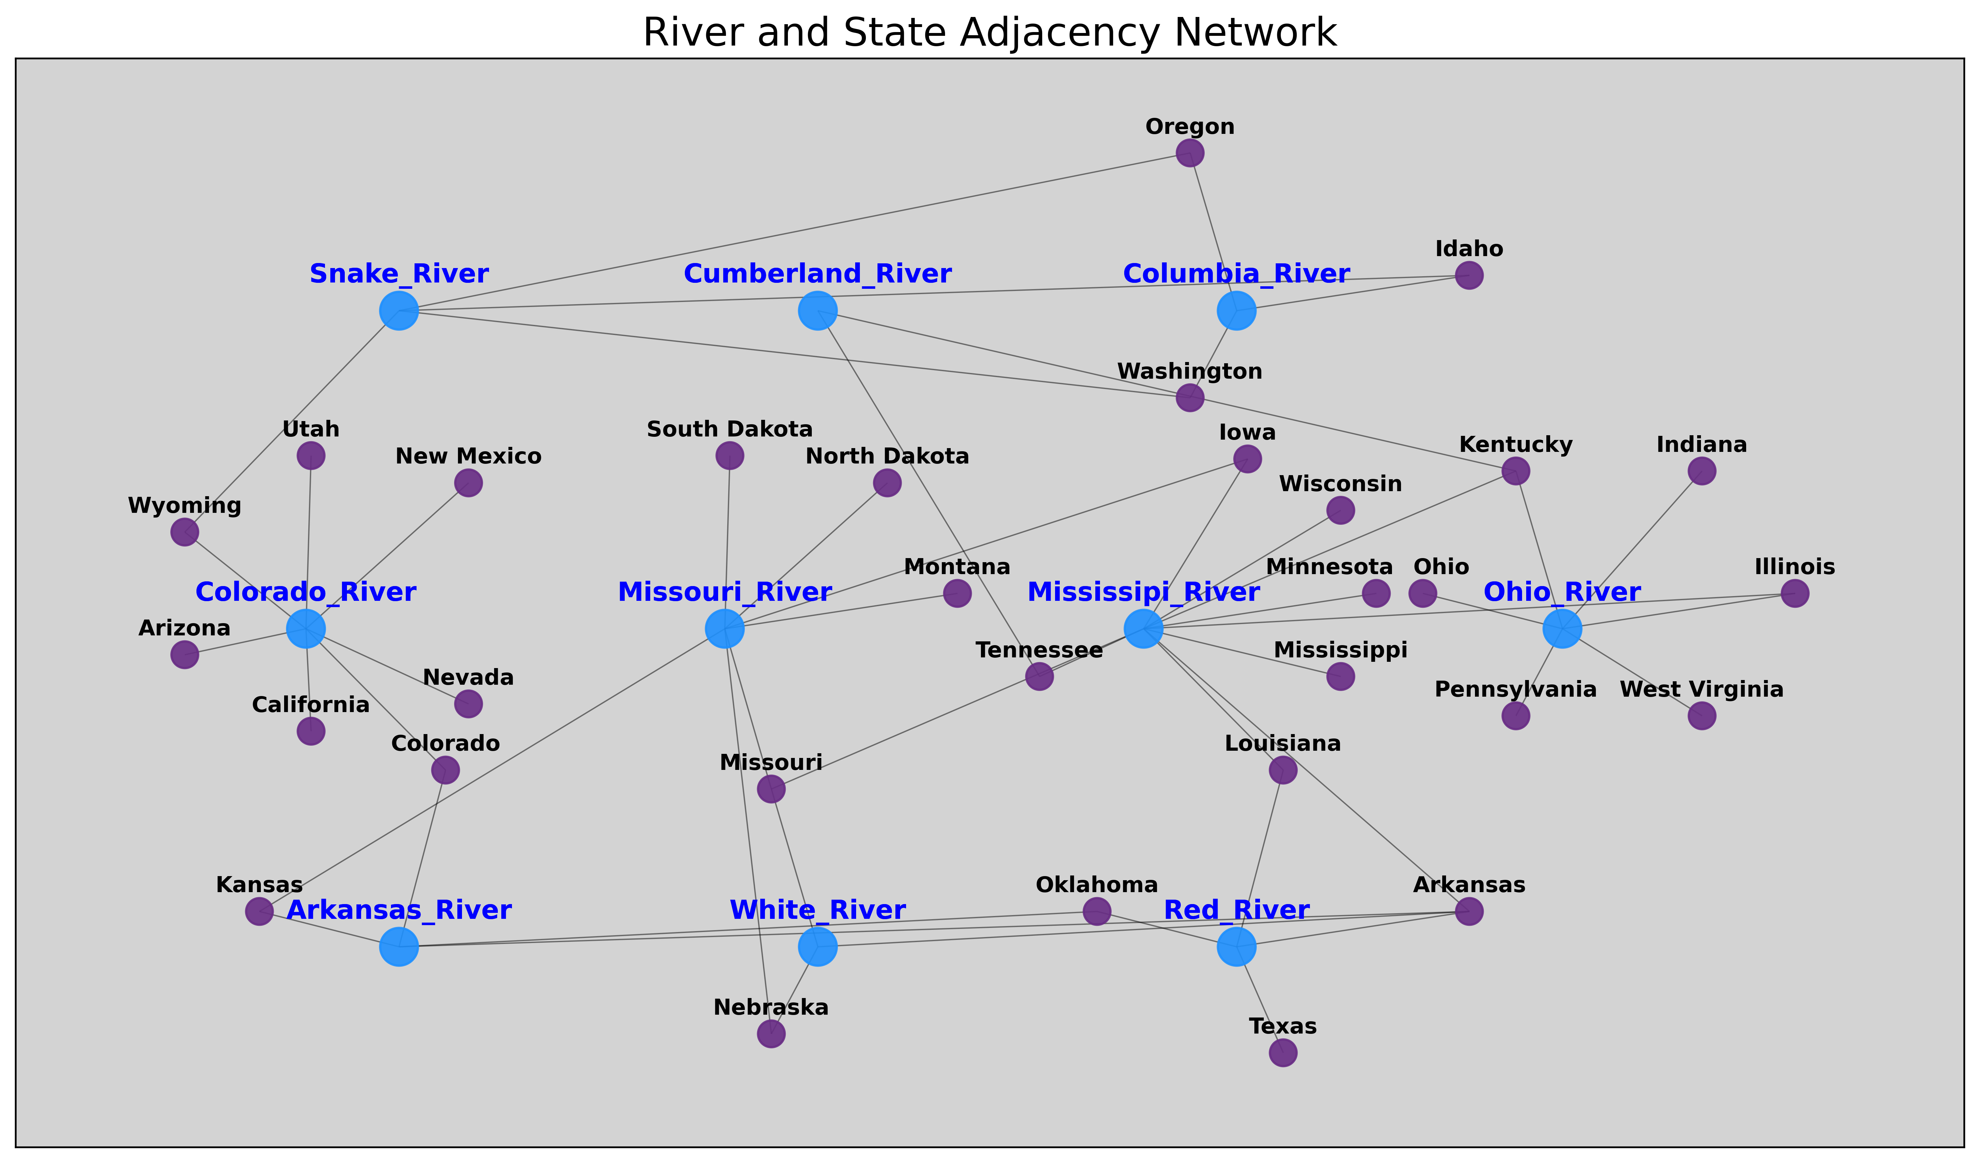
Nodal Visualizations of States and Superfund Sites
Next Steps:
1. Convert data to node-and-edge format.
2. Combine data by joining graphs.
3. Layer data into the nodal representations as characteristics.
4. Conduct statistical tests.
5. Develop model/s.

Slide 15
References [1] L. Aiello and S. Banerjee, “Detecting Spatial Health Disparities Using Disease Maps,” Sep. 05, 2023, arXiv: arXiv:2309.02086. doi: 10.48550/arXiv.2309.02086.
[2] A. Saha, M. Ghorbani, D. Suleimenova, A. Anagnostou, and D. Groen, “Impact of geography on the importance of parameters in infectious disease models,” Oct. 20, 2023, arXiv: arXiv:2310.02449. doi: 10.48550/arXiv.2310.02449.
[3] T. Q. Tan, R. Kullar, T. H. Swartz, T. A. Mathew, D. A. Piggott, and V. Berthaud, “Location Matters: Geographic Disparities and Impact of Coronavirus Disease 2019,” The Journal of Infectious Diseases, vol. 222, no. 12, pp. 1951–1954, Nov. 2020, doi: 10.1093/infdis/jiaa583.
[4] S. Shiode, “Revisiting John Snow’s map: network-based spatial demarcation of cholera area,” International Journal of Geographical Information Science, vol. 26, no. 1, pp. 133–150, Jan. 2012, doi: 10.1080/13658816.2011.577433.
[5] L. Beale, J. J. Abellan, S. Hodgson, and L. Jarup, “Methodologic Issues and Approaches to Spatial Epidemiology,” Environmental Health Perspectives, vol. 116, no. 8, pp. 1105–1110, Aug. 2008, doi: 10.1289/ehp.10816.
[6] Y. Cui, K. M. Eccles, R. K. Kwok, B. R. Joubert, K. P. Messier, and D. M. Balshaw, “Integrating Multiscale Geospatial Environmental Data into Large Population Health Studies: Challenges and Opportunities,” Toxics, vol. 10, no. 7, p. 403, Jul. 2022, doi: 10.3390/toxics10070403.
[7] M. Rezaeian, G. Dunn, S. St Leger, and L. Appleby, “Geographical epidemiology, spatial analysis and geographical information systems: a multidisciplinary glossary,” Journal of Epidemiology & Community Health, vol. 61, no. 2, pp. 98–102, Feb. 2007, doi: 10.1136/jech.2005.043117.
[8] A. Vora, D. S. Burke, and D. A. T. Cummings, “The impact of a physical geographic barrier on the dynamics of measles,” Epidemiol. Infect., vol. 136, no. 5, pp. 713–720, May 2008, doi: 10.1017/S0950268807009193.
[9] V. Harish et al., “Human movement and environmental barriers shape the emergence of dengue,” Nat Commun, vol. 15, no. 1, p. 4205, May 2024, doi: 10.1038/s41467-024-48465-0.
[10] R. Maheswaran, C. Craigs, S. Read, P. A. Bath, and P. Willett, “A graph-theory method for pattern identification in geographical epidemiology – a preliminary application to deprivation and mortality,” Int J Health Geogr, vol. 8, no. 1, p. 28, May 2009, doi: 10.1186/1476-072X-8-28.
[11] D. Bucur and P. Holme, “Beyond ranking nodes: Predicting epidemic outbreak sizes by network centralities,” PLoS Comput Biol, vol. 16, no. 7, p. e1008052, Jul. 2020, doi: 10.1371/journal.pcbi.1008052.
[12] L. M. Smith, K. Lerman, C. Garcia-Cardona, A. G. Percus, and R. Ghosh, “Spectral Clustering with Epidemic Diffusion,” Phys. Rev. E, vol. 88, no. 4, p. 042813, Oct. 2013, doi: 10.1103/PhysRevE.88.042813.
[13] Z. Ma and L. Rennert, “An epidemiological modeling framework to inform institutional-level response to infectious disease outbreaks: a Covid-19 case study,” Sci Rep, vol. 14, no. 1, p. 7221, Mar. 2024, doi: 10.1038/s41598-024-57488-y.
[14] A. L. Bowring, D. Ten Brink, R. Martin-Hughes, N. Fraser-Hurt, N. Cheikh, and N. Scott, “Evaluation of the use of modelling in resource allocation decisions for HIV and TB,” BMJ Glob Health, vol. 9, no. 1, p. e012418, Jan. 2024, doi: 10.1136/bmjgh-2023-012418.
[15] R. Selvan, B. Pepin, C. Igel, G. Samuel, and E. B. Dam, “PePR: Performance Per Resource Unit as a Metric to Promote Small-Scale Deep Learning in Medical Image Analysis,” Dec. 05, 2024, arXiv: arXiv:2403.12562. doi: 10.48550/arXiv.2403.12562.
[16] A. Crisan, “The Importance of Data Visualization in Combating a Pandemic,” Am J Public Health, vol. 112, no. 6, pp. 893–895, Jun. 2022, doi: 10.2105/AJPH.2022.306857.
[17] K. Motoki, T. Saito, and Y. Takano, “Scientific Literacy Linked to Attitudes Toward COVID-19 Vaccinations: A Pre-Registered Study,” Front. Commun., vol. 6, p. 707391, Jul. 2021, doi: 10.3389/fcomm.2021.707391.

